Slide 1

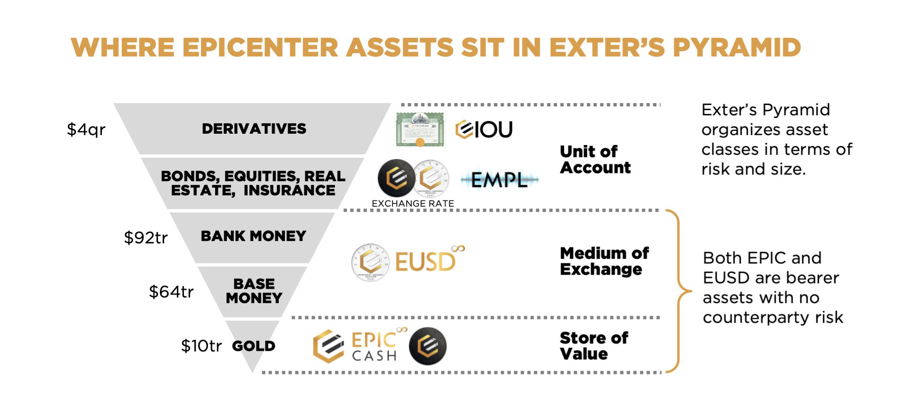


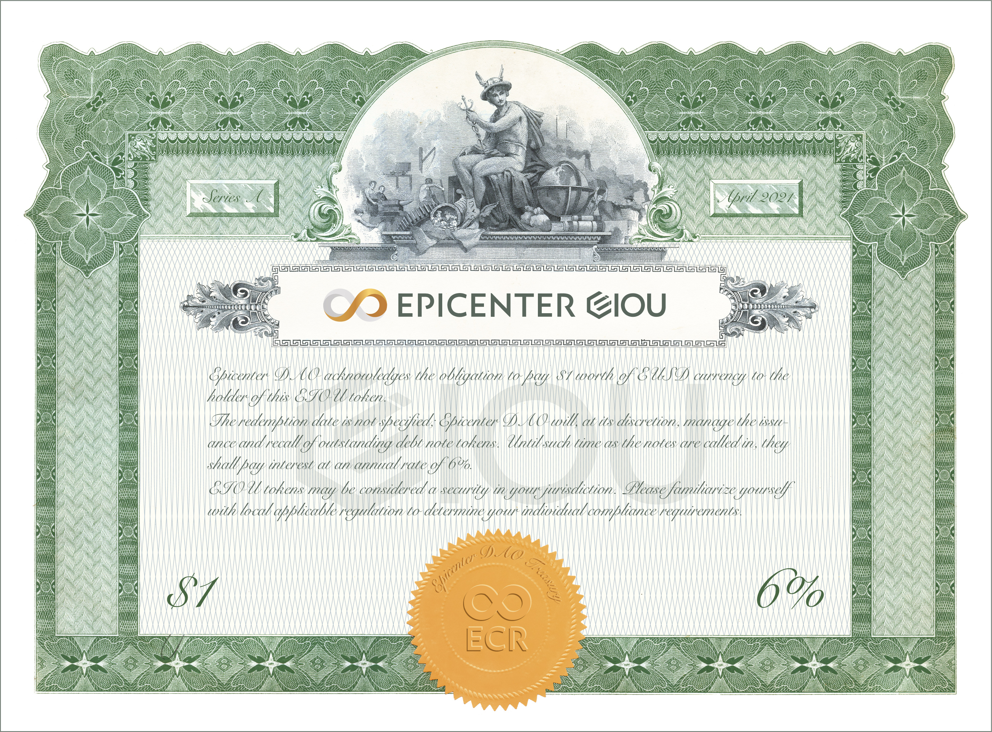


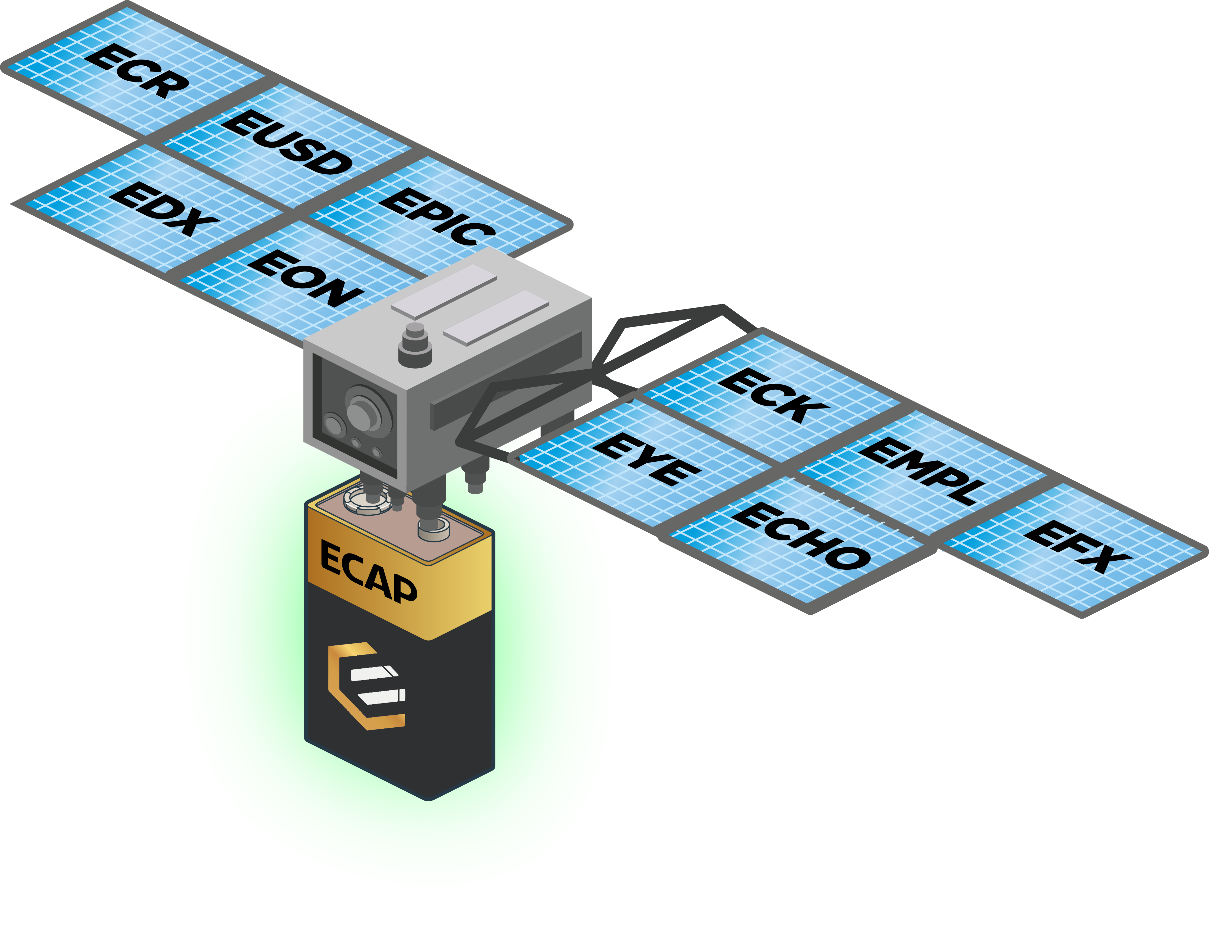




EPICENTER CAPITAL ROLES
TRUSTLESS
PERMISSIONLESS
CENSORSHIP RESISTANT
UNSTOPPABLE
Epicenter USD Short Term Notes redeemable on demand for $1 worth of EPIC. Does not incur interest costs. Can never by blocked, blacklisted or frozen.
Epicenter IOU Long Term Bonds callable for 1 EUSD. Provides interest yield of ECR tokens at a governance-specified daily rate.
Epicenter Token // Every Citizen’s Reserve Equity & governance token is the primary seigniorage beneficiary.
Epicenter Capital Accumulation Protocol Preferred equity receives a share of seigniorage and uses it to buy back & burn its own token.
POWERED BY:
CONFIDENTIAL, DECENTRALIZED, SOUND MONEY WITH INTEGRITY

